Slide 1
Week 6A – Actuators I
Advanced Mechatronics System Design – MANU2451
Dr Chow Yin LAI
Edited by Dr Milan Simic School of Engineering RMIT University, Victoria, Australia Email: milan.simic@rmit.edu.au

Slide 2
New Teaching Schedule
Week |  | Class Activity Before | Lecture | Class Activity During or After
1 |  |  | Introduction to the Course / Introduction to LabVIEW | LabVIEW Programming
2 |  |  | Introduction to LabVIEW / Data Acquisition | LabVIEW Programming
3 |  |  | Gripper / Introduction to Solidworks / Safety | Gripper Design
4 |  |  | Sensors I | myRIO Programming for Sensor Signal Reading / Gripper Design
5 |  |  | Sensors II | myRIO Programming for Sensor Signal Reading
6 |  |  | Actuators I | LabVIEW Tutorial
7 |  | LabVIEW Assessment. | DC Motors I | Matlab Simulink Simulation
8 |  | Design report submission | DC Motors II | Matlab Simulink Simulation / myRIO Programming for Control
9 |  |  | Actuators II | Matlab Simulink Simulation Gripper CAD
10 |  |  | Modeling and System Identification | Matlab Simulink Simulation / Gripper simulation testing
11 |  |  | Artificial Intelligence I | Matlab Simulation / Finalize Gripper
12 |  | Gripper Simulation / Submission of Report | Artificial Intelligent II | Revision

Slide 3
Assessment 2020
LabView assessment (Individual online Quiz) on week 7 (22/04) – 20%
Design assessment (Team) on Tuesday of week 8 (29/04) – 10%
A brief written Report, with figures of the gripper assembly, and explanation of the components.
Also, explain choice of design, calculation etc.
Submit Gripper Simulation Program and Report (Team) on week 12 (27/05) 10% and 40% respectively.
Report template is given in the course folder.
Final exam (Individual) – 20%
Online Quiz .
Will be on Wednesday of Week 14.

Slide 4
Mechatronics System Components
D/A, Amplifier, PWM etc.
Output Signal Conditioning and Interfacing
Actuators
Sensors
Input Signal Conditioning and Interfacing
Digital Control Architectures
Microcontroller, Control Algorithm, PLC, etc.
DC Motor, Stepper,
Servo etc.
Mechanical
Computer
Electrical / Electronics
Control Systems
Potentiometer, Strain gauge, Encoder etc.
A/D, Filters, Amplifiers etc.

Slide 5

Mechatronics System Components
Sensors: Encoder at each joint
Input signal interfacing
Robot controller:
Generate desired motion trajectory
Calculate current end-effector position based on angular position (kinematics)
Calculate desired angular position for desired end-effector position and trajectory (inverse kinematics)
Control algorithm
Safety, collision detection etc.
Industrial Robots
https://commons.wikimedia.org/wiki/File:Float_Glass_Unloading.jpg
Actuators: Geared motor at each joint
Output signal interfacing

Slide 6
Content
Introduction
Solenoids and Voice Coil Actuators
Stepper Motors
Magnetic Levitation
Permanent Magnet DC Motors
Electromagnet DC Motors
Brushless DC Motors

Slide 7
Content
Introduction
Solenoids and Voice Coil Actuators
Stepper Motors
Magnetic Levitation
Permanent Magnet DC Motors
Electromagnet DC Motors
Brushless DC Motors

Slide 8
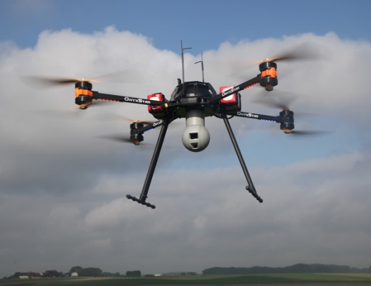
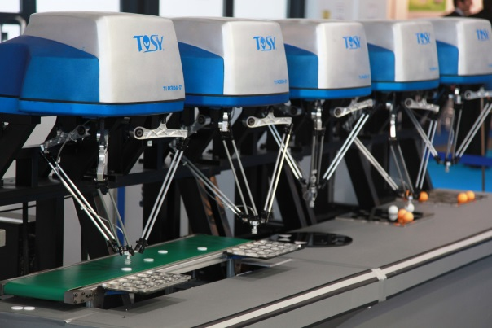
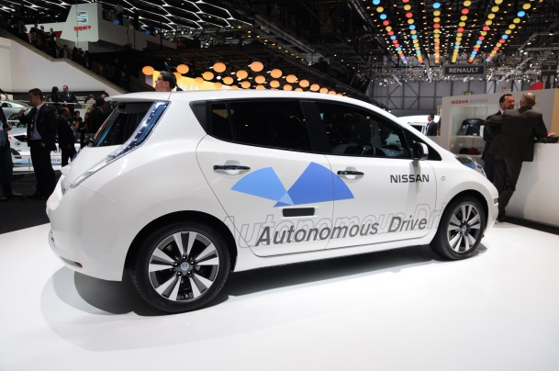
Introduction
Actuators are responsible for moving or controlling a mechanism.
They produce physical changes such as linear and angular displacement.
Engine/Motor for motion; Motor for steering
Motors
Motors
Quadcopter
https://commons.wikimedia.org/wiki/File:Onyxstar_Fox-C8_XT_xender_360.jpg
Delta Robots
https://commons.wikimedia.org/wiki/File:TOSY_Parallel_Robot.JPG
Autonomous Vehicle
https://commons.wikimedia.org/wiki/File:2014-03-04_Geneva_Motor_Show_1186.JPG

Slide 9
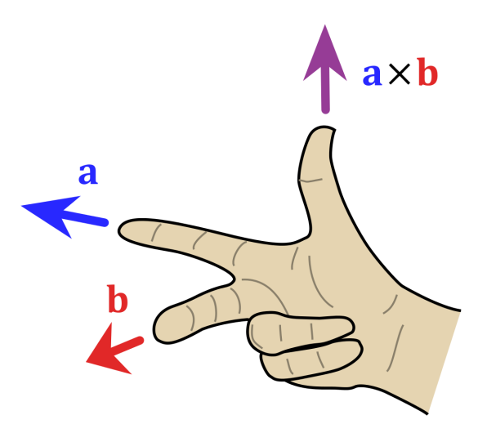
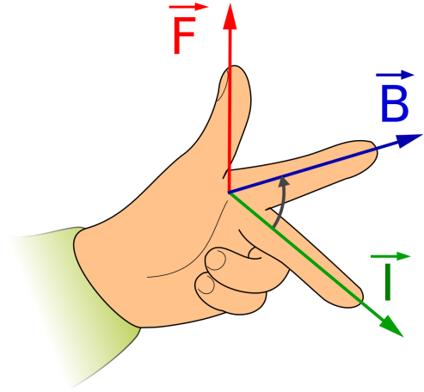
Electromagnetic Principles
Many actuators rely on electromagnetic forces to create their action.
Lorentz’s force law:
When a current-carrying conductor is moved in a magnetic field, a force is produced perpendicular to both the current and magnetic field directions.
To find the direction of force:
F
I
B
Note the difference!!
Right Hand Rule
https://commons.wikimedia.org/wiki/File:Right_hand_rule_cross_product.svg
Fleming’s Left Hand Rule
https://commons.wikimedia.org/wiki/File:ManoLaplace.svg

Slide 10
Magnetic Reluctance
Another principle used on designing actuators is called magnetic reluctance / magnetic resistance.
A magnetic field causes the magnetic flux to follow the path of least magnetic resistance.

Slide 11
Content
Introduction
Solenoids and Voice Coil Actuators
Stepper Motors
Magnetic Levitation
Permanent Magnet DC Motors
Electromagnet DC Motors
Brushless DC Motors

Slide 12
Solenoids
Movable iron core (Armature)
1. Coil energized with current
2. Magnetic field created
Stationary iron core
Coil
Spring
Air gap
Force can be increased by increasing current, number of turns and permeability of core.
On-off applications such as latching, locking and triggering.
E.g. washing machine valves, door latches.
3. The core moves to reduce magnetic reluctance (magnetic field resistance) by closing the air gap
4. Spring pushes armature back when current is turned off

Slide 13
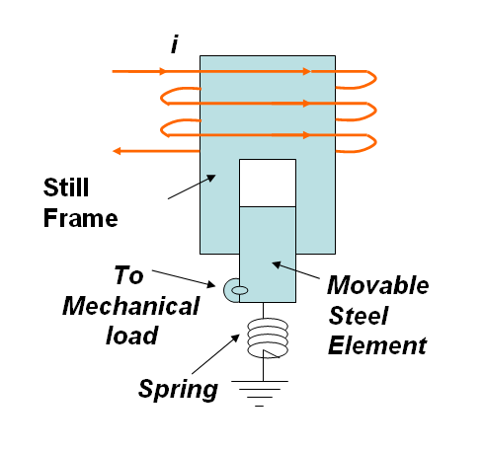
Solenoid Actuator
One of the most popular actuators in automotive engineering
Solenoid is treated as a very good electro-mechanical switching device.

Slide 14
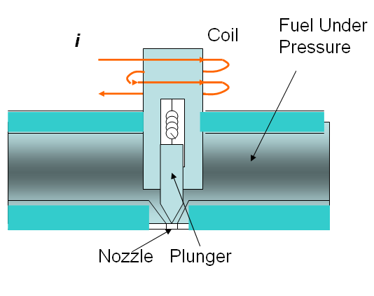
Fuel Injector
Solenoid has many applications in the vehicle including
fuel injection
Exhaust Gas Recirculation (EGR) valves.
For example, the fuel injector is basically a solenoid-operated valve .
Piezo actuators

Slide 15
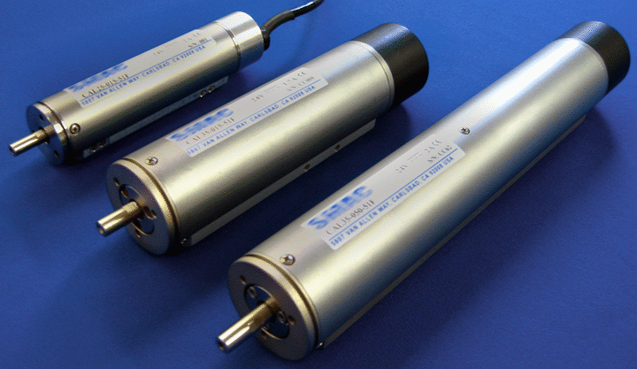
Voice Coil Actuators
“Voice coil” is the coil of wire attached to the apex of a loudspeaker cone.
Provides motive force to the cone by reaction of magnetic field to the current passing through it.
Nowadays found in many applications such as hard-disk drive read-write head, stabilization platforms, shaker.
https://www.youtube.com/watch?v=Bjk7gjJVkPE
https://www.youtube.com/watch?v=3owqvmMf6No
Linear Voice Coil Motor
https://commons.wikimedia.org/wiki/File:Multi-cylinders.gif

Slide 16
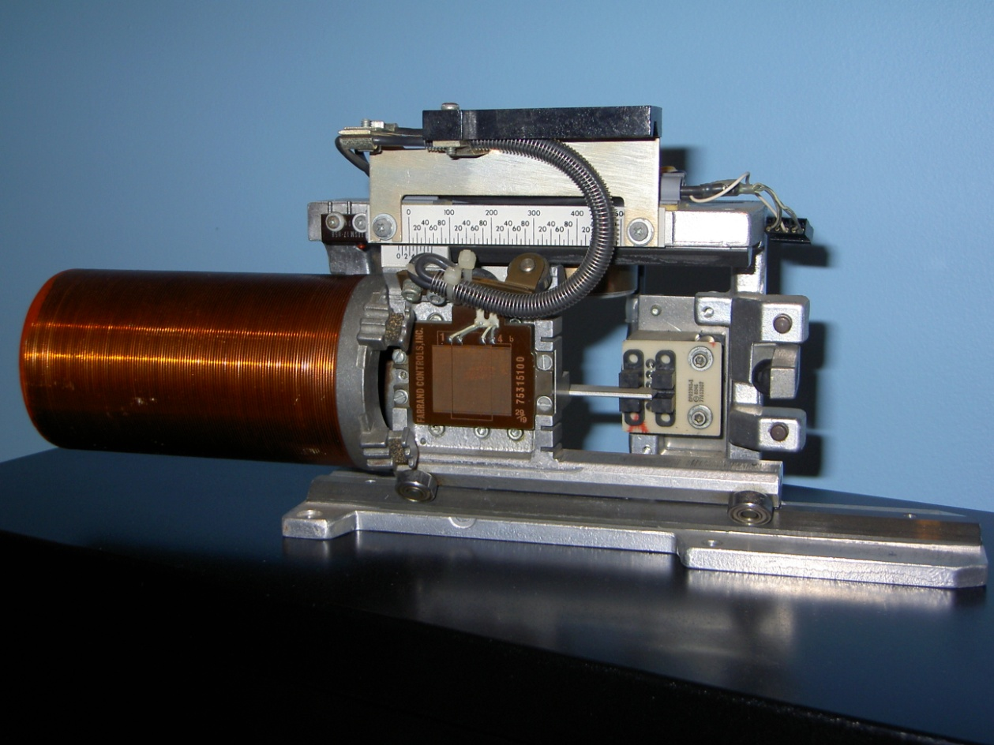
Linear Voice Coil Actuator
Visual track display
Photo Sensors
Track Zero
Heads on Switch
Capacitive Track
Sensor
Voice Coil
Motor
Rail

Slide 17
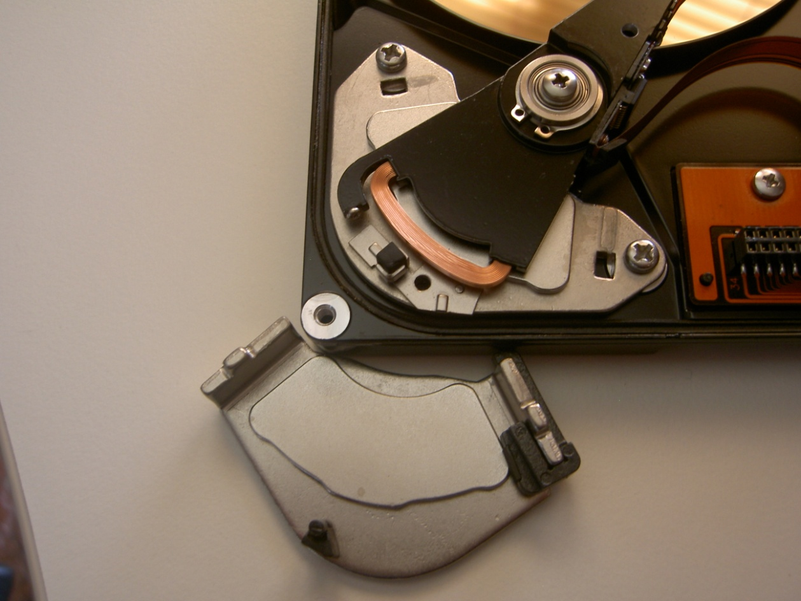
Rotary Voice Coil Actuator
Voice Coil
Permanent Magnet

Slide 18
Voice Coil Actuators
Principle of Operation:
Advantages:
Linear response
Small mass of moving coil
Bidirectional capability
No Backlash
F
F
Moving Coil
Current into plane
Current out of plane
.
.
x
.
x
x
.
.
x
x
.
.
B
.
x
B
B
x
.
B
.
x
x
.
.
x
x
.
x
x
Permanent Magnet
N
N
S
S
Soft iron core
Excellent for control applications

Slide 19
Content
Introduction
Solenoids and Voice Coil Actuators
Stepper Motors
Magnetic Levitation
Permanent Magnet DC Motors
Electromagnet DC Motors
Brushless DC Motors

Slide 20
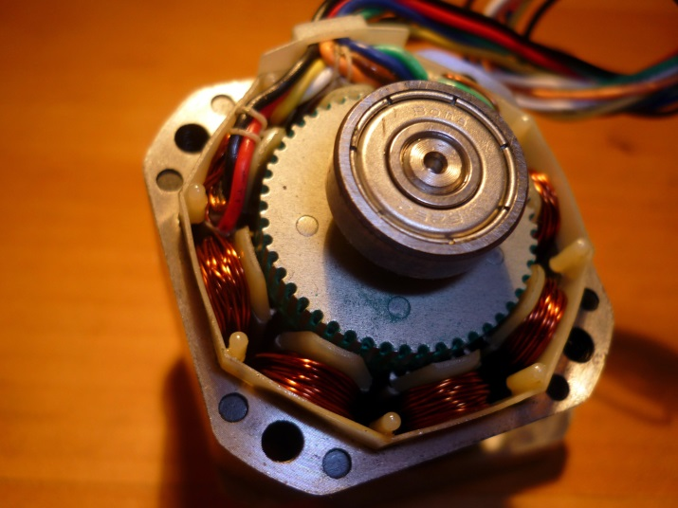
Stepper Motor
Brushless motor which rotates in discrete steps.
Can be operated in open loop control, no feedback required.
Provide definite amount of pulses / steps → Motor will move to the desired position.
The main reason for use of stepper motors.
However, the use of feedback can increase accuracy.
Steps are usually 1.8̊, 2̊, 2.5̊, 5̊, 15̊, 30̊.
Special circuitry can provide micro-stepping.
Generally less than 1 hp (746W) thus only for low-power applications.
Usage examples: Scanners, printers, CD drives, camera lenses, 3D printers.
Stepper Motor
https://commons.wikimedia.org/wiki/File:Stepper_motor.jpg

Slide 21
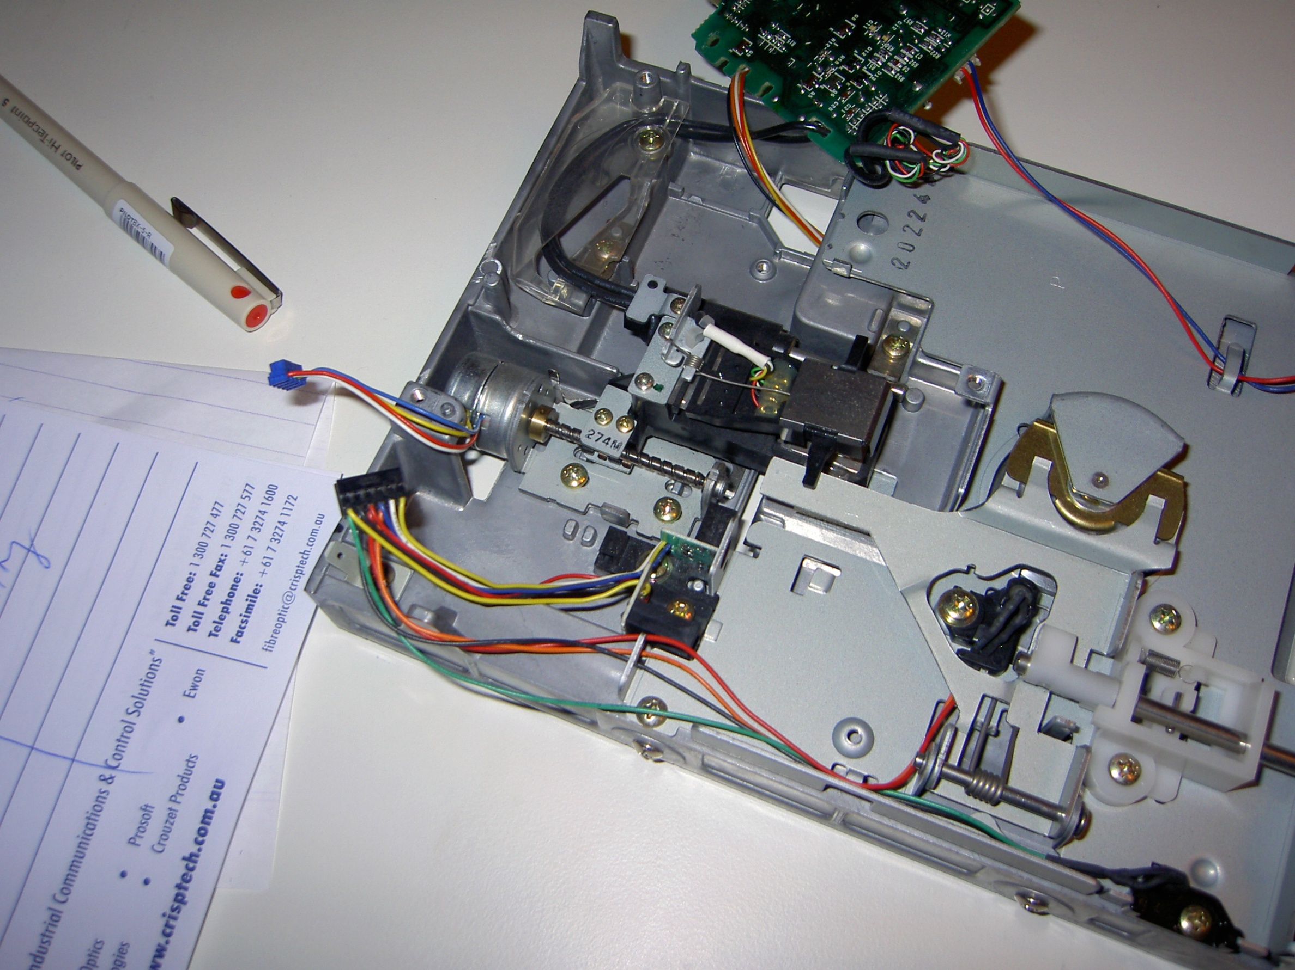
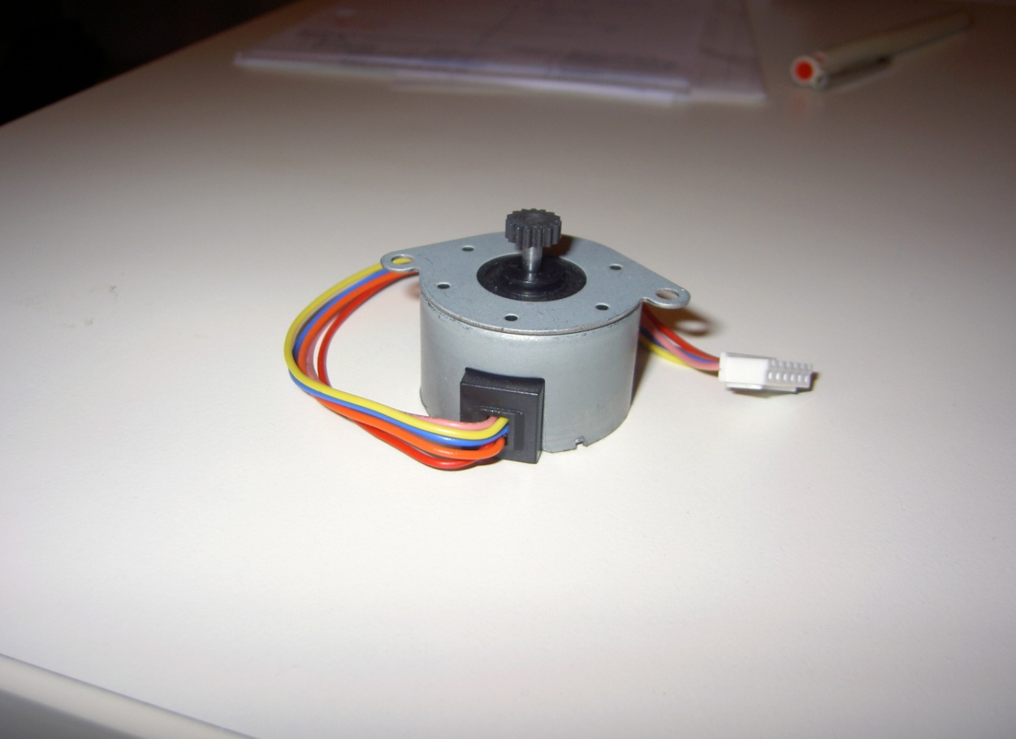
Step / Stepper / Stepping Motors
Motor 1
Floppy Disk RW Positioning Head Motor
96 tpi (tracks per inch)
Motor 2
Single step is 7.5 degrees
360 / 7.5 = 48

Slide 22
Step Motor Control
Motor is driven by current pulse (±1A)
When continuos pulses are applied angle displacement is directly proportional to the number of pulses
Can rotate clockwise or anti- clockwise
Can be controlled by single loop circuit
There is no need for the feedback control network

Slide 23
Step Pulses
Stepper drive input signals consist of step pulses and a direction signal.
One step pulse is required for every step.
Unipolar Drive
Bipolar Drive
(more efficient)

Slide 24
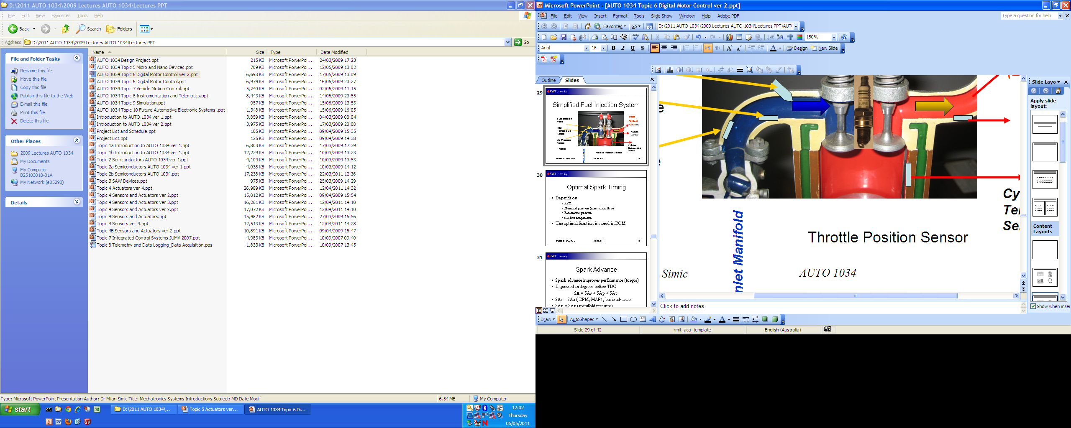
Cruise Control
Speed
Sensor
I/O
Interface
System
Busses
Microcontroller
System
Driver
Circuit
Throttle Actuator
(Step Motor)
Throttle
Position

Slide 25
Step Motor Actuator for Cruse Control
Data
bus
Counter
Step Motor
Coil 1
Step Motor
Coil 2
Clock
Phase A
Oscillator
Phase B
Oscillator
SB

Slide 26
Stepper Motor - Types
N
S
Permanent Magnet
Variable Reluctance
Hybrid Synchronous

Slide 27
PM Stepper: 1-Phase Full Step Drive
Let’s consider the permanent magnet stepper motor first.
A
A
A
A
B
S
B
B
B
B
B
B
B
N
N
S
S
N
N
S
A
A
A
A
A
1 coil energized at a time: 1-Phase.
Every time the next coil is energized, the rotor moves 90˚: full-step.
Not widely used:
Low resolution
Low torque (due to single phase)
B
A
B

Slide 28
2-Phase Full Step Drive
We can increase the torque if we use the 2-Phase Full-Step Drive:
A
A
A
A
B
B
B
B
B
B
B
B
S
N
N
S
N
S
S
N
A
A
A
A
A
2 coils energized at a time: 2-Phases.
The current vector is between the two energized coils.
Every time the other coil is energized, the rotor moves 90˚: full-step.
→ No increase in resolution!
B
A
B

Slide 29
1-2-Phases Half Step Drive
To increase the resolution, we can switch between 1 & 2 phases:
A
A
A
A
B
S
B
B
B
B
B
B
N
B
S
N
S
N
N
S
A
A
A
A
Continue on next slide.

Slide 30
1-2-Phases Half Step Drive
To increase the resolution, we can switch between 1 & 2 phases:
A
A
A
A
B
N
B
B
B
B
B
B
B
N
S
S
N
S
S
N
A
A
A
A
The rotor turns 45 → Increased resolution!
However, there will be torque ripple!
Due to different strengths of magnetic field when 1 coil and when 2 coils are energized.
A
B
A
B

Slide 31
1-2-Phases Half Step Drive
To reduce the torque ripple, we can alter the currents:
When running 1 coil, use full amount of current.
When running 2 coils, use reduced current.
This can be achieved for e.g. by using Pulse Width Modulation.
A
B
A
B

Slide 32
DC Motor Control Modes
Pulse Width Modulation
V
V
DC Level
PWM
t
The amount of energy transferred to the motor,
Effective value, RMS (root-mean-square)

Slide 33
DC Motor Control
Voltage applied to armature controls speed
Chopping DC supply voltage, known as PWM (Pulse Width Modulation)
Supply
voltage
time
Chopped
voltage
time

Slide 34

Calculate Average and RMS Values as Functions of Pulse Width
PWM
v₂
A
A/2
t
0 T/2 T 2T 3T

Slide 35
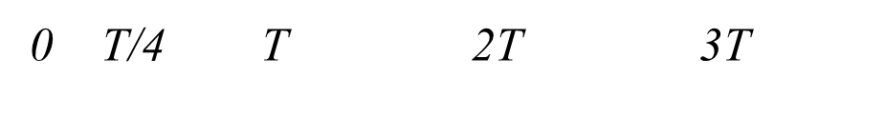
PWM
v₁
A
v₂
A
A/2
Compare the energy supplied to the motor
t
t
0 T/2 T 2T 3T

Slide 36
Micro-Stepping
Now, since we already use methods such as Pulse Width Modulation to alter the currents, why not do it at an even finer resolution?!
The current can be controlled to follow the shape of sine waves (top half), which increments in fine steps:
10,000 or more steps per revolution can be achieved!
Microstepping minimizes torque ripple, as well as ringing and overshoot.
A
B
A
B

Slide 37
Variable Reluctance Stepper Motor
Ferromagnetic (soft iron core) rotor instead of permanent magnet.
A
A
A
A
B
B
B
B
B
B
B
B
A
A
A
A
A
Attraction of stator and rotor poles to position with minimum magnetic field resistance.
Lower rotor inertia than permanent magnet stepper motor.
Faster dynamic response.
B
A
B

Slide 38
Variable Reluctance Stepper Motor
It can also be run using half-step drive (shown below) or microstepping.
A
A
A
A
B
B
B
B
B
B
B
B
A
A
A
A
A
B
A
B

Slide 39
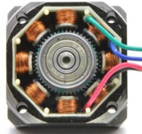
Hybrid Synchronous Stepper Motor
A “combination” of permanent magnet stepper motor and variable reluctance stepper motor.
Double-Salient design: There are teeth on both the rotor and stator.
The rotor has 2 teeth more than stator.
E.g. if stator has 48 teeth, then rotor has 50 teeth.
A
B
B
N
S
A
S
A
Hybrid Synchronous Stepper
https://commons.wikimedia.org/wiki/File:Stepper_motor..png
The rotor is magnetized axially, not radially
B
B
A
Looking from rotor’s south end

Slide 40
Principle of Operation
A and A-bar are energized at the same time but with opposite phases.
Left: Rotor’s S attracted to Stator’s N, and vice versa.
Right: By changing position of poles, the rotor rotates (not very obvious due to small angle.)
Again, half stepping or micro-stepping are possible.
A
A
B
B
B
B
A
S
A
A
S
A
B
B
B
B
A
A

Slide 41
Torque-Speed Curve
It is important to know how to read a torque/speed curve.
It describes what a stepper motor can and cannot do.
Start/Stop Region: For any load value in this region, the motor can start, stop or reverse “instantly” (no ramping required) at the corresponding speed.
Holding Torque
Torque / Nm
Pulled-out Torque
Start/Stop Region
Speed / Pulse per second
Pulled-in Torque
Slew Region

Slide 42
Torque-Speed Curve
It is important to know how to read a torque/speed curve.
It describes what a stepper motor can and cannot do.
Pull-in Torque: Maximum torque at given speeds for which the motor can start, stop or reverse instantaneously with the input pulses.
Holding Torque
Torque / Nm
Pulled-out Torque
Start/Stop Region
Speed / Pulse per second
Pulled-in Torque
Slew Region

Slide 43
Torque-Speed Curve
It is important to know how to read a torque/speed curve.
It describes what a stepper motor can and cannot do.
Slew Region: To maintain synchronism, the motor speed must be ramped (adjusted gradually).
Holding Torque
Torque / Nm
Pulled-out Torque
Start/Stop Region
Speed / Pulse per second
Pulled-in Torque
Slew Region

Slide 44
Torque-Speed Curve
It is important to know how to read a torque/speed curve.
It describes what a stepper motor can and cannot do.
Pull-out Torque: Maximum torque at given speeds that motor can generate while running in synchronism. If the motor runs outside of this curve, it will stall.
Holding Torque
Torque / Nm
Pulled-out Torque
Start/Stop Region
Speed / Pulse per second
Pulled-in Torque
Slew Region

Slide 45
Torque-Speed Curve
It is important to know how to read a torque/speed curve.
It describes what a stepper motor can and cannot do.
Holding Torque: Amount of torque that the motor produces when it has rated current flowing through the windings but the motor is at rest.
Holding Torque
Torque / Nm
Pulled-out Torque
Start/Stop Region
Speed / Pulse per second
Pulled-in Torque
Slew Region

Slide 46
Advantages and Disadvantages
Advantages:
No feedback required: Rotation angle is proportional to input pulse.
Precise positioning and repeatability: Good stepper motors have an accuracy of 3-5% of a step, and this error is non-cumulative.
Motor has full torque at standstill if windings are energized.
Rotor remains in a position and can withstand an opposing torque up to a value called the “holding torque”.
High torque at start-up and low speeds.

Slide 47
Advantages and Disadvantages
Disadvantages:
Resonance can occur if not properly controlled.
Not easy to operate at extremely high speed.
Due to inertia of rotor and attached load, rotation might not move, or might exceed the desired number of steps → “Slip”. The motor must be sufficiently oversized to prevent this.
A
θ
B
B
N
S
t
A

Slide 48
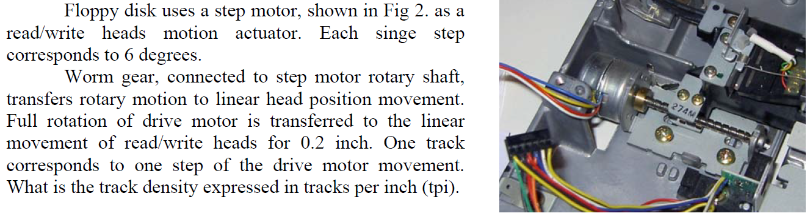
Floppy Disk Drive Steps

Slide 49
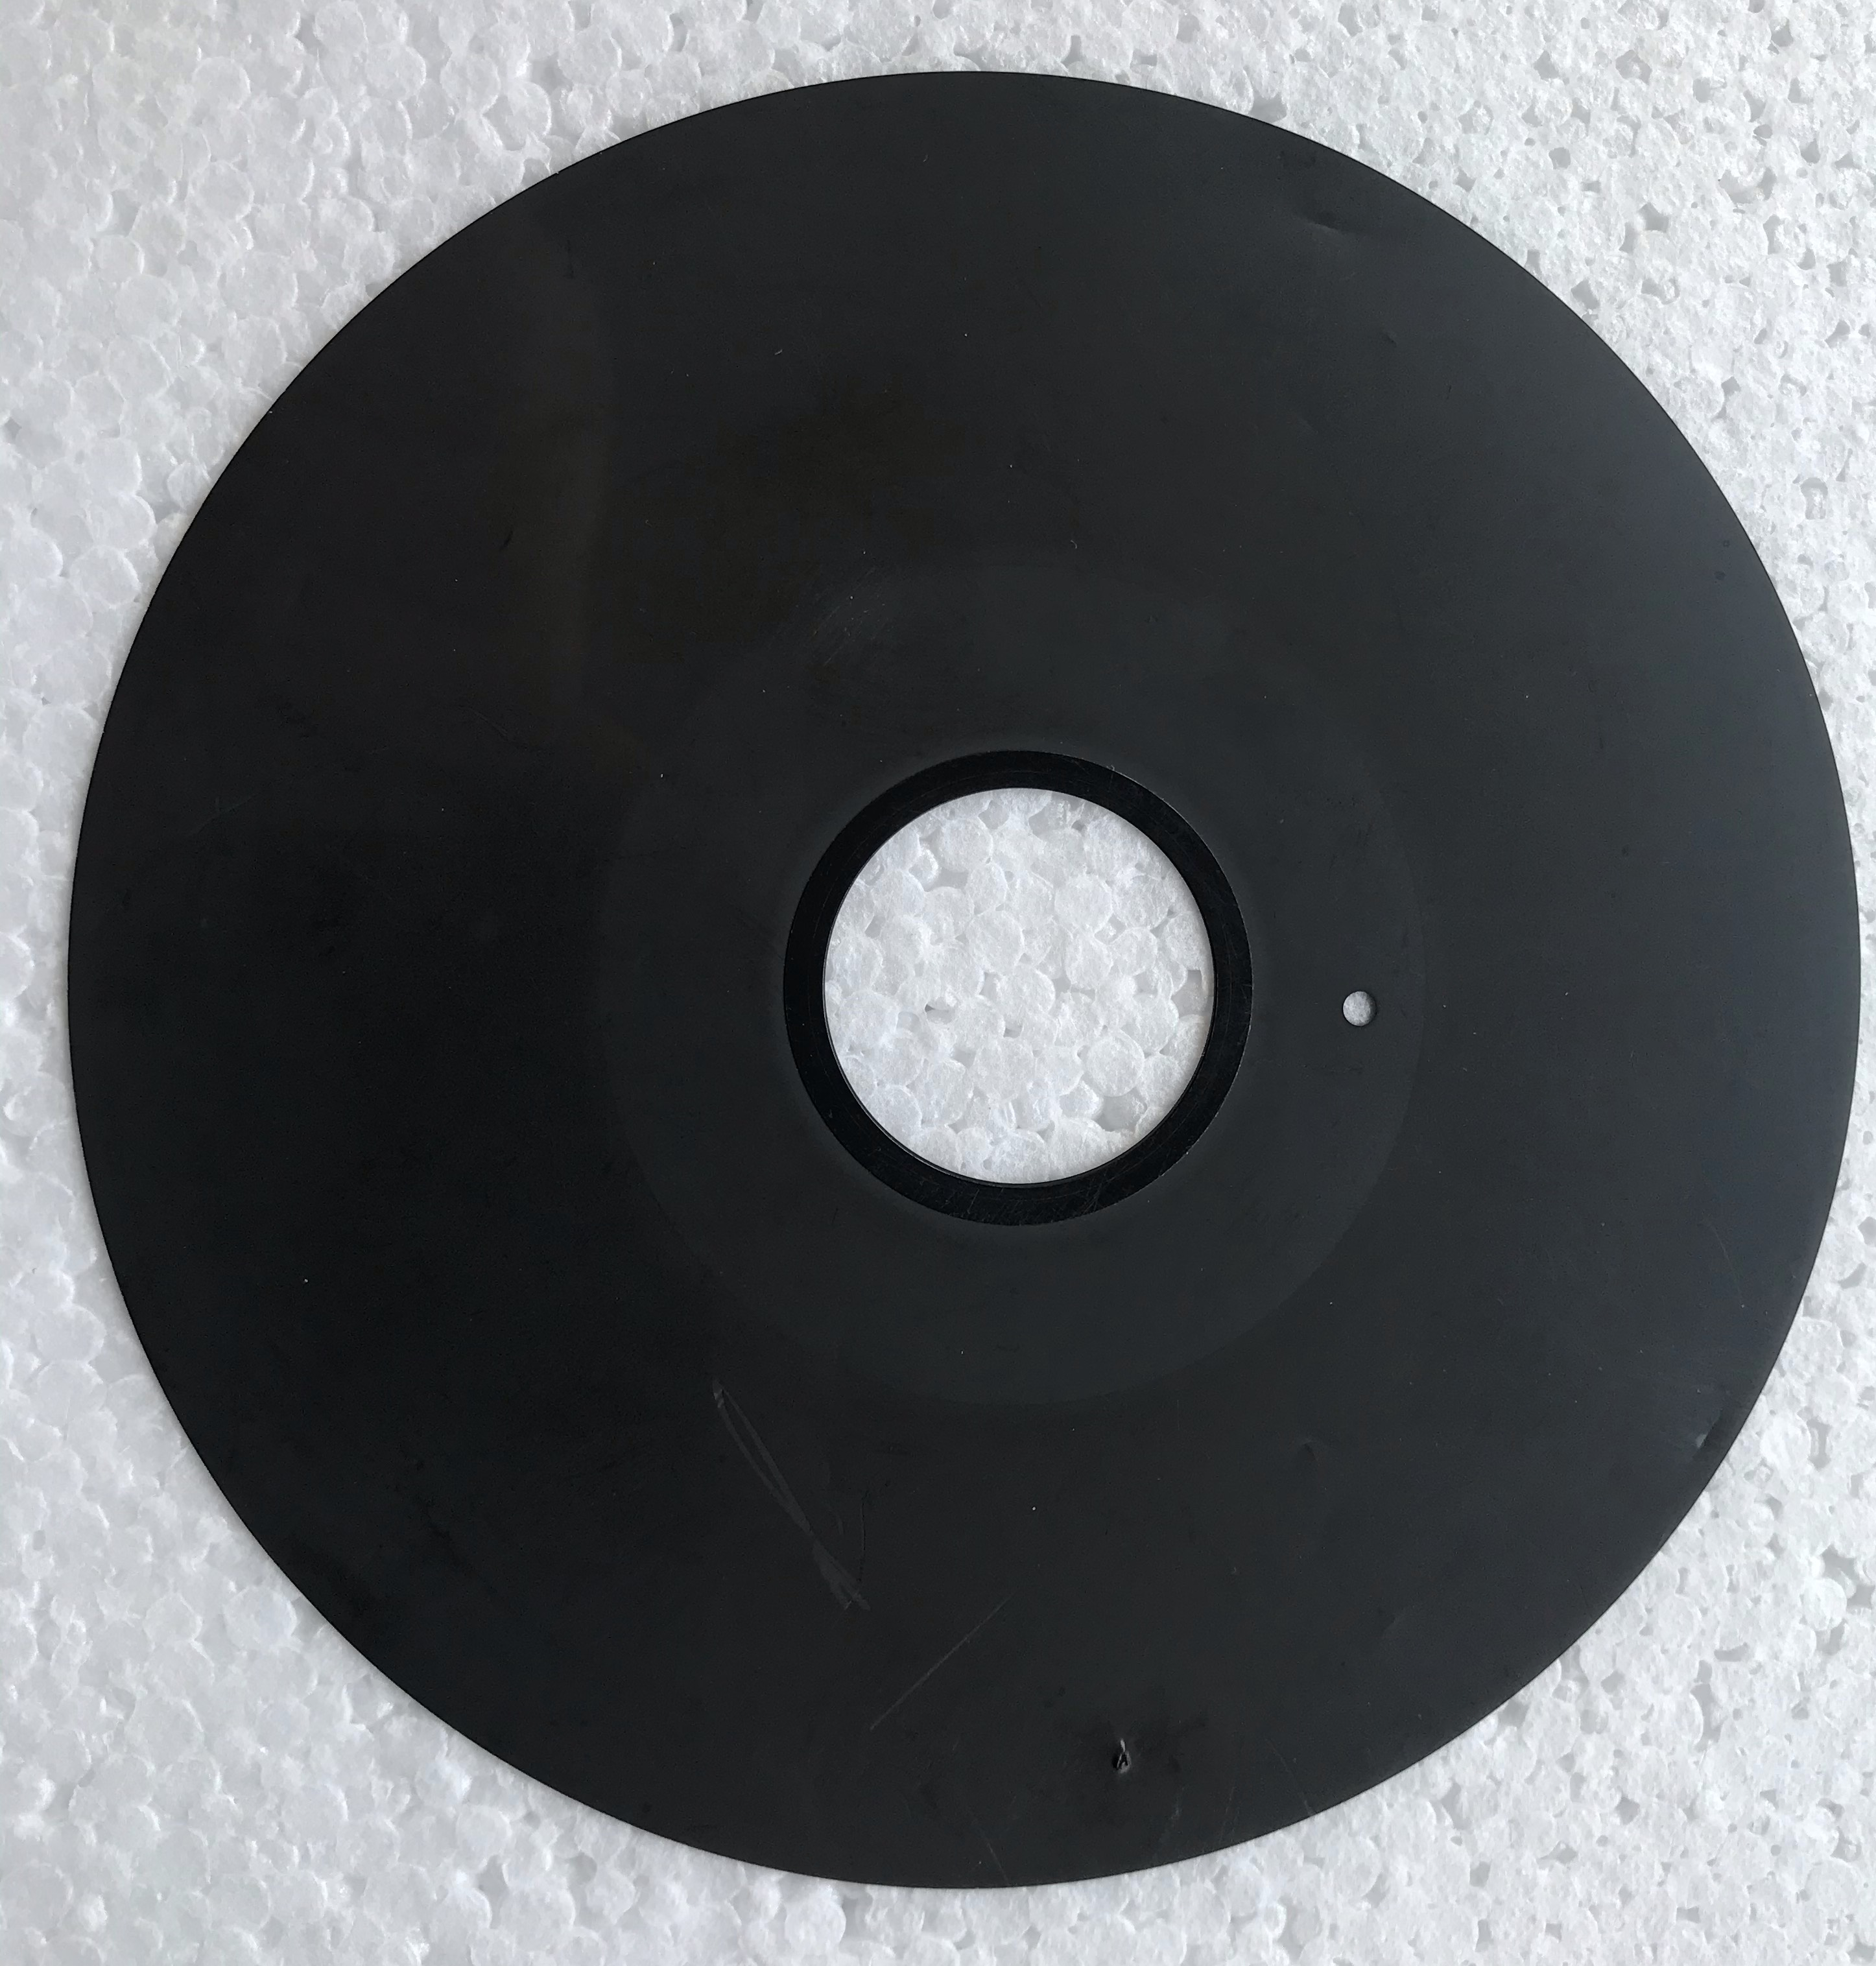
Floppy Disk Drive Steps
360/6 = 60 steps per rotation
60 steps => 0.2 inch
300 steps => 1 inch
1 Step => 1 track
Track density = 300 tpi (tracks per inch)

Slide 50
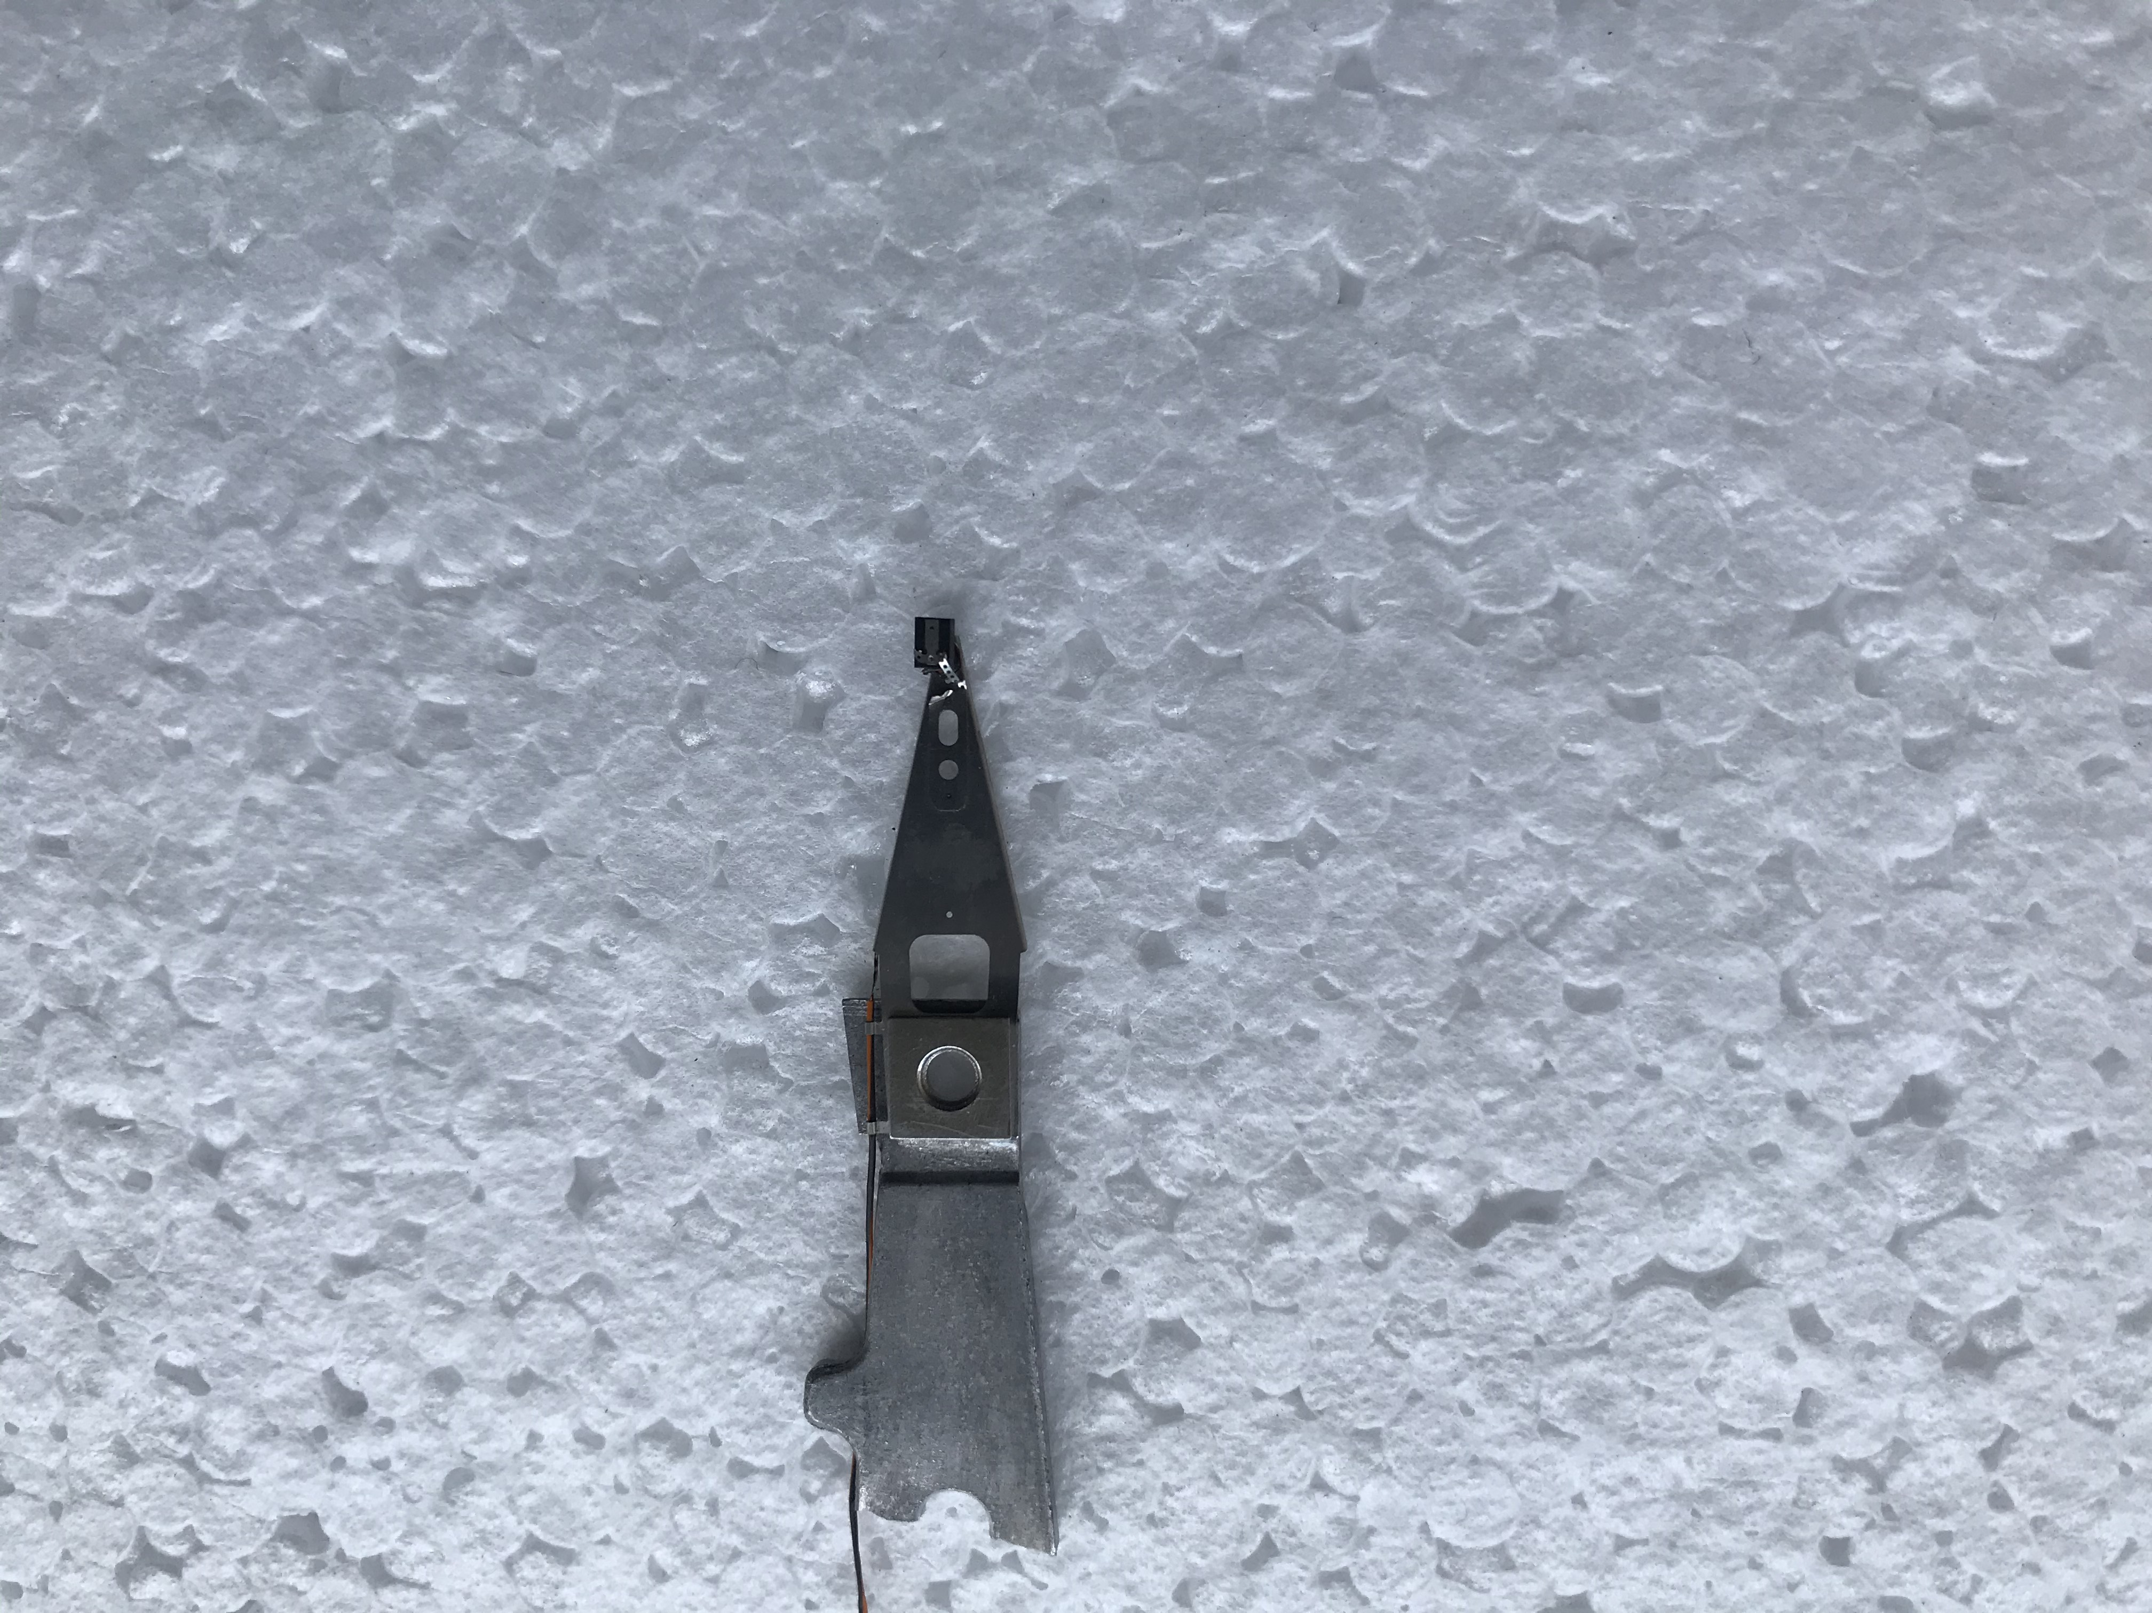
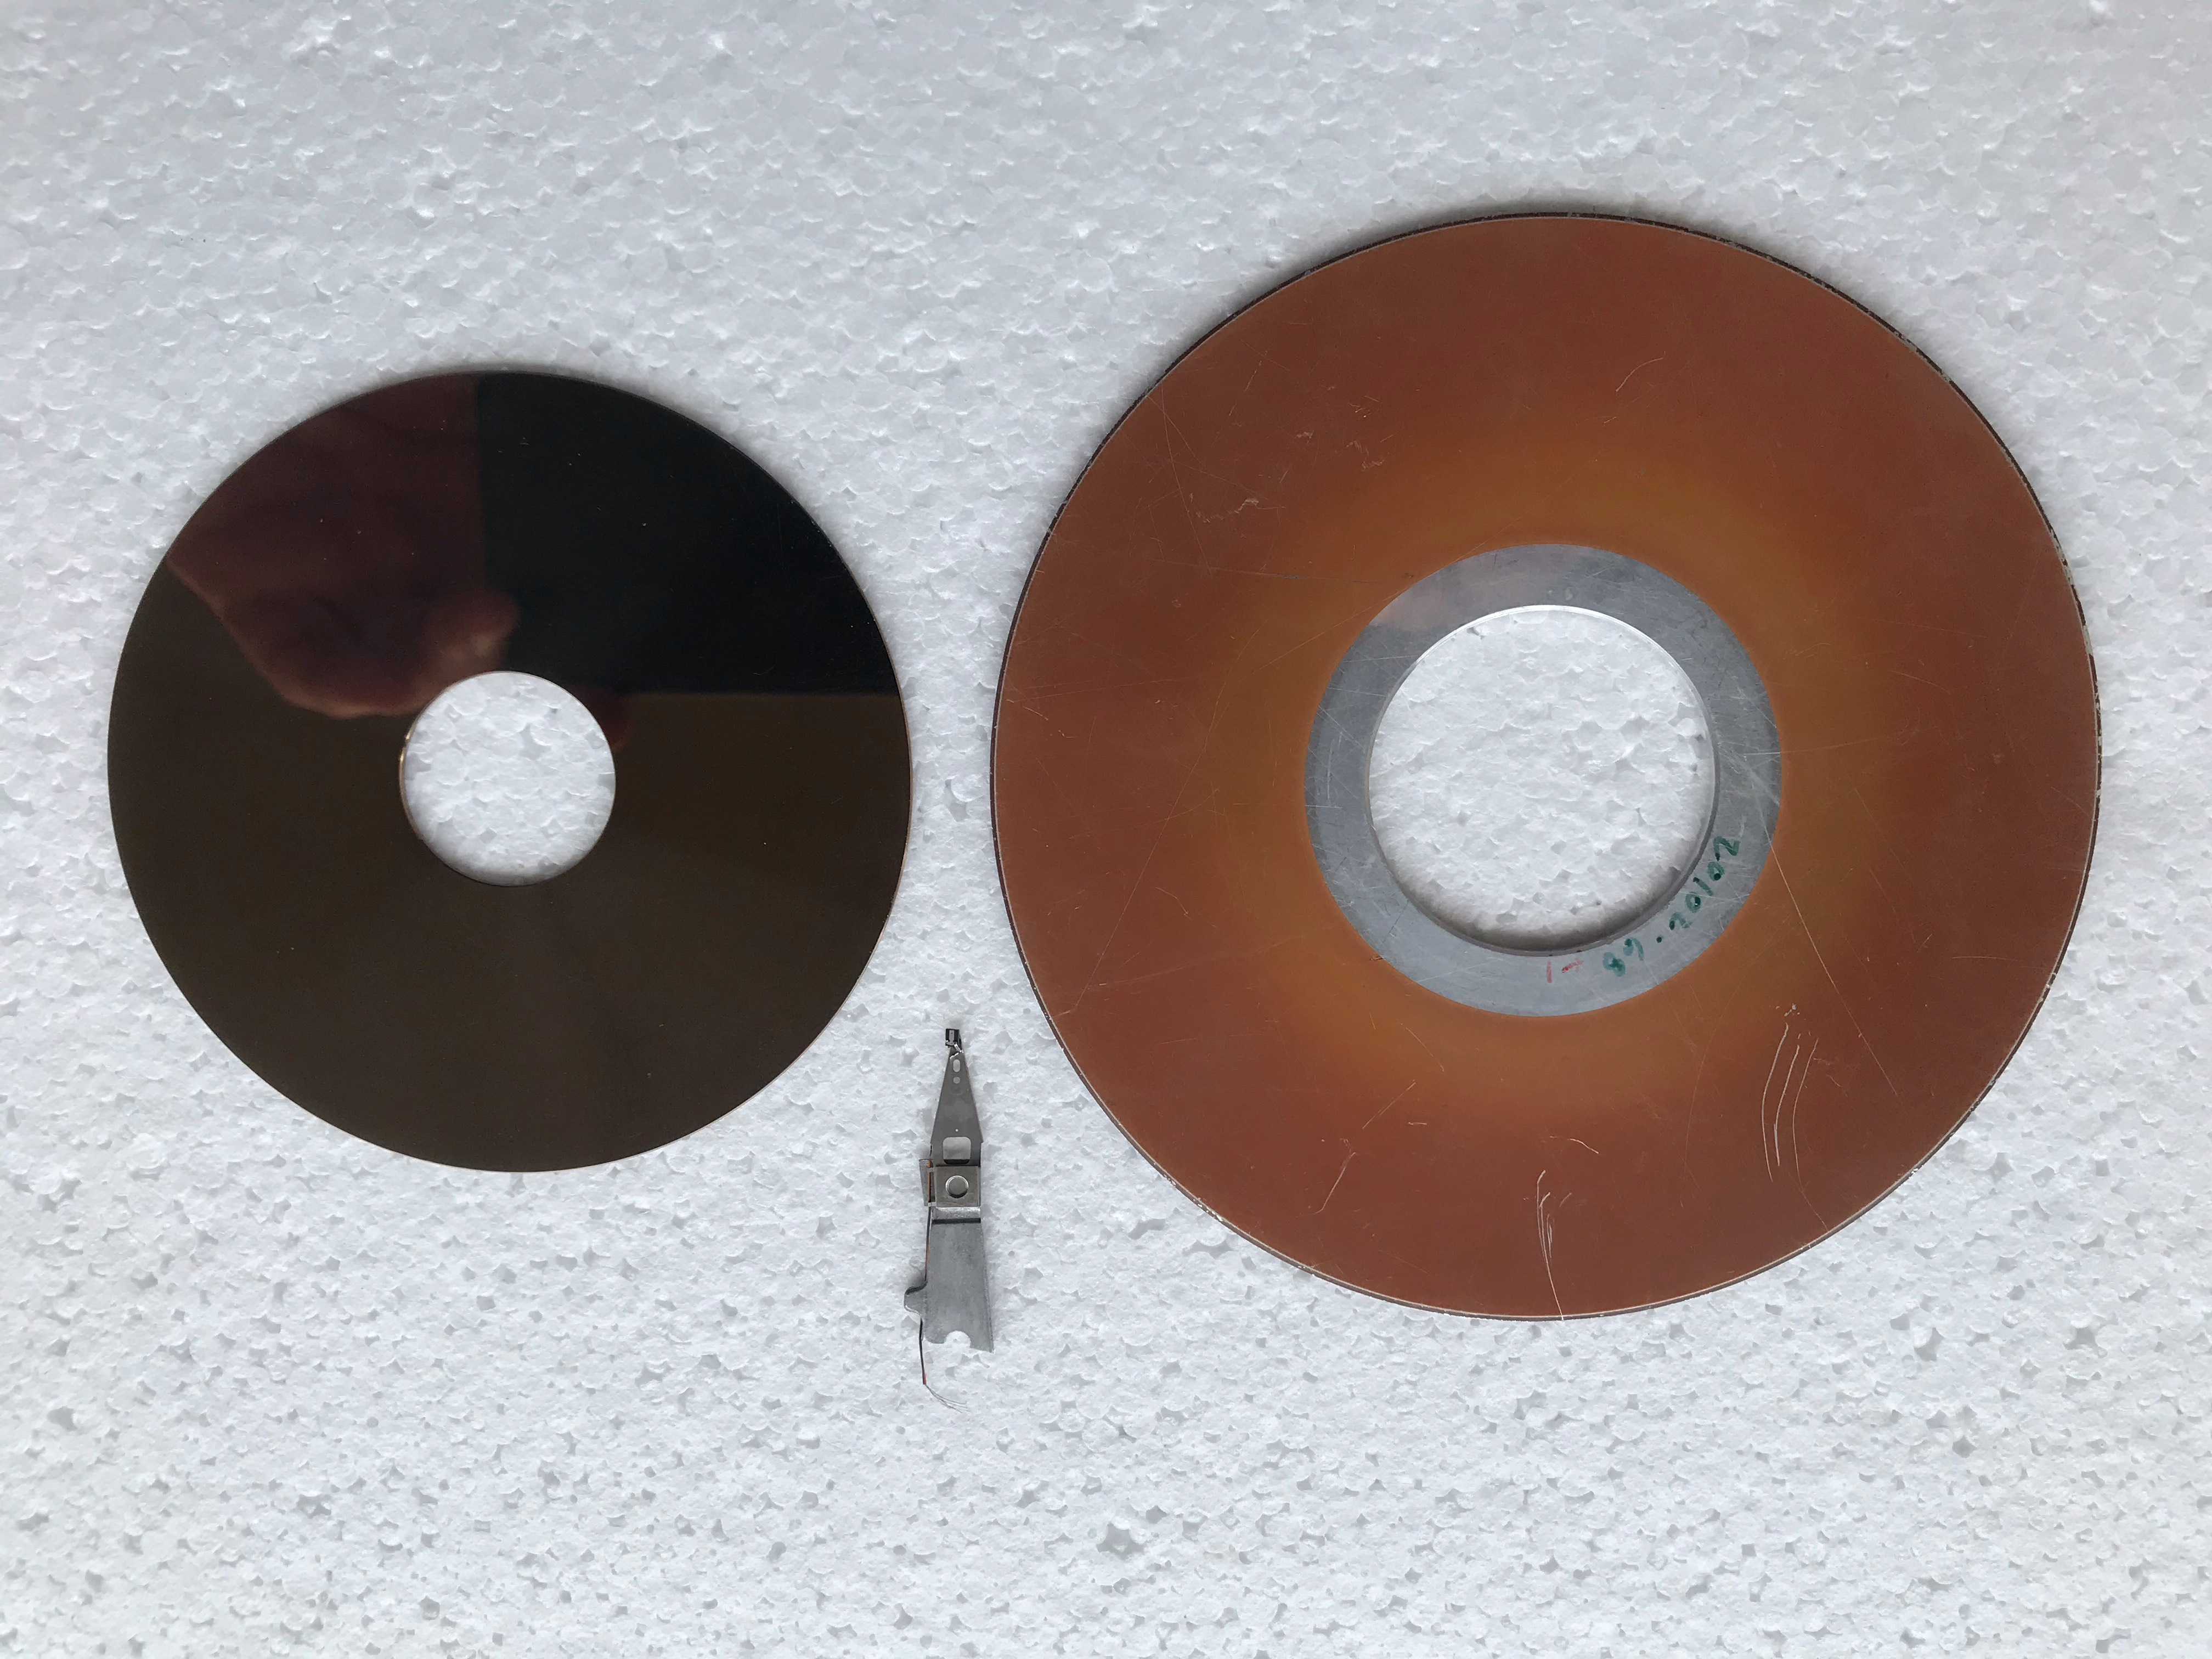
Hard Disk (HD) Drive Tracks
HDs are using rotary voice coil
Find out what is track resolution per inch (tpi) for a modern HD

Slide 51
Content
Introduction
Solenoids and Voice Coil Actuators
Stepper Motors
Magnetic Levitation
Permanent Magnet DC Motors
Electromagnet DC Motors
Brushless DC Motors

Slide 52
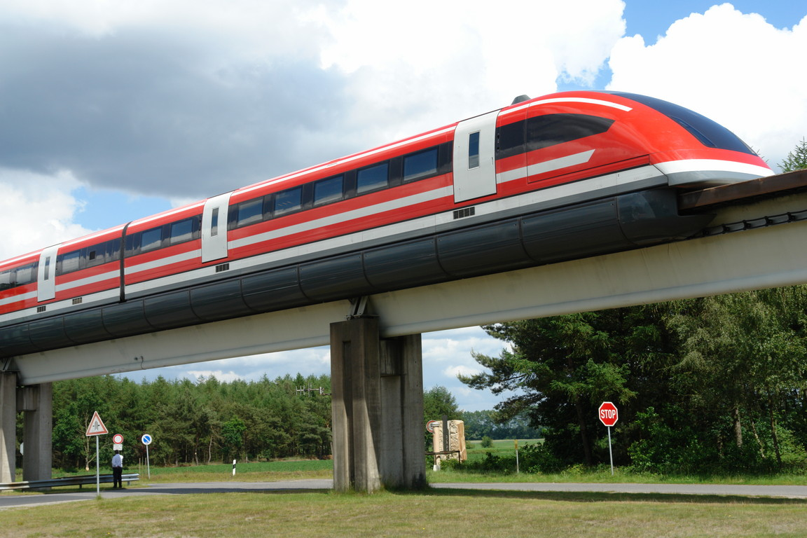
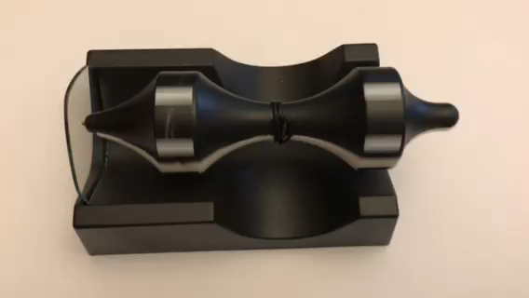
Magnetic Levitation
A method to move vehicles without touching the ground.
Minimal friction, thus allowing very high speed.
Maglev Train
https://commons.wikimedia.org/wiki/File:Transrapid-emsland.jpg

Slide 53
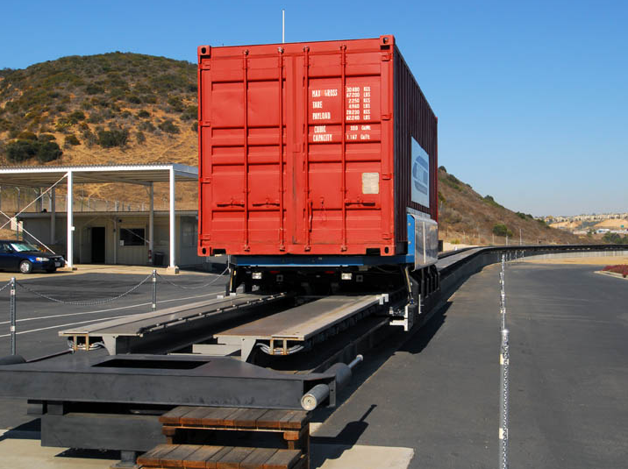
Magnetic Levitation
Because of the contactless operation, nearly zero friction.
Thus, magnetic levitation is also being applied to build “clean conveyor” or positioning stages in production which needs extreme cleanliness. E.g.
Semiconductor
Display (e.g. LCD)
https://www.youtube.com/watch?v=KZEO4sYLoSA
Other proposed systems which makes use of magnetic levitation technology include:
Ropeless Elevator
Hover Boards
Hover Car
Cargo Conveyor
Space Launch
Maglev Cargo
http://www.railwaygazette.com/news/single-view/view/freight-maglev-on-test.html

Slide 54
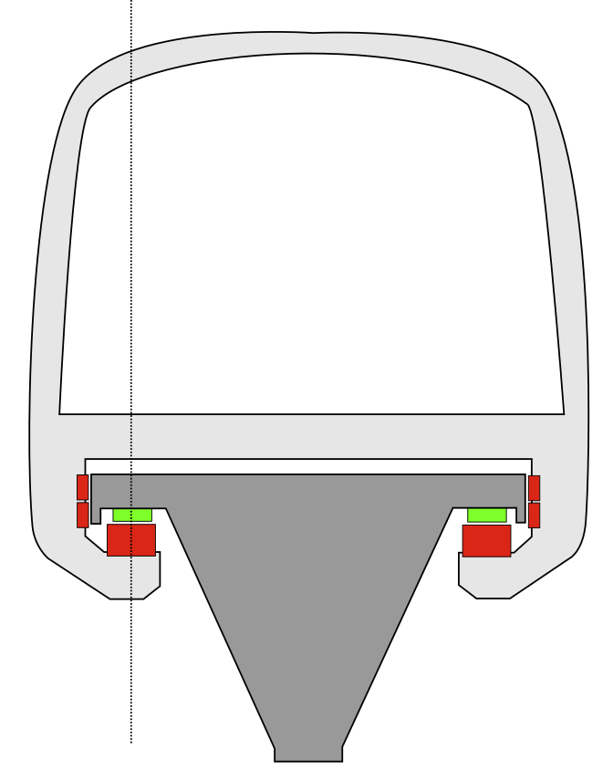
Principles of Operation
Two separate magnetic systems in place to achieve the following:
Levitation
Propulsion
Levitation:
Magnet on rail (green) & magnet on train “arm” (red) are of different polarity → Attracts & levitate
Magnetic attraction varies inversely with the cube of distance, so minor changes in distance between the magnets and the rail produce greatly varying forces
Needs good feedback control
Maglev Levitation https://commons.wikimedia.org/wiki/File:Magnetschwebebahn.svg

Slide 55
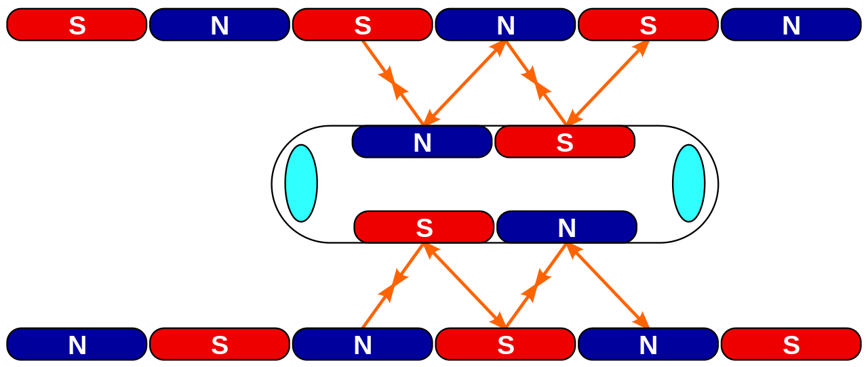
Principles of Operation
Propulsion:
Opposite poles attract; Same poles repels
Maglev Propulsion https://commons.wikimedia.org/wiki/File:Maglev_Propulsion.svg

Slide 56

Principles of Operation
Propulsion:
After one step, the guidance magnet changes pole:

Slide 57
Content
Introduction
Solenoids and Voice Coil Actuators
Stepper Motors
Magnetic Levitation
Permanent Magnet DC Motors
Electromagnet DC Motors
Brushless DC Motors

Slide 58
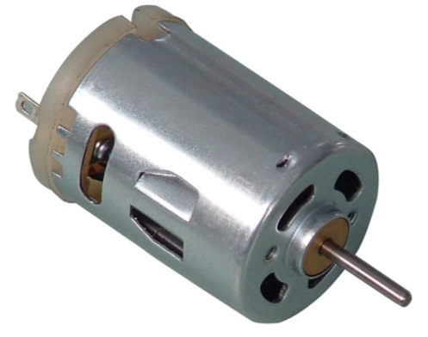
DC Motor
Converts direct current electrical power into mechanical power.
Widely used in mechatronic devices.
Small: Tools, toys and appliances.
Large: Electric vehicles, elevator, drives for steel rolling mills.
DC Motor
https://commons.wikimedia.org/wiki/File:DC_Motor.jpg

Slide 59
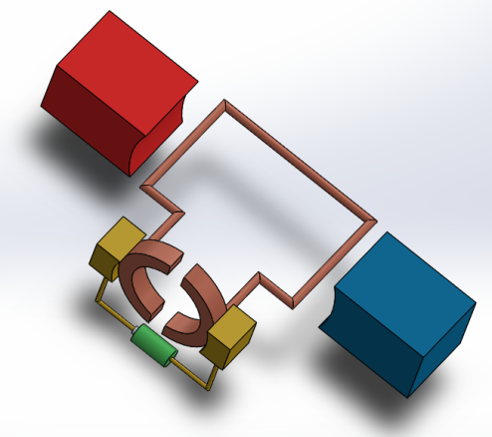
DC Motor: Terminology
A Basic DC motor:
Permanent Magnet
(North)
Armature (Rotating Coil)
Brush:
Spring loaded to maintain contact.
Earlier: bristles of copper wire;
Now: Graphite (larger contact area and self-lubricating)
Commutator Ring
+
Permanent Magnet
(South)
-
Battery / DC Power Supply

Slide 60
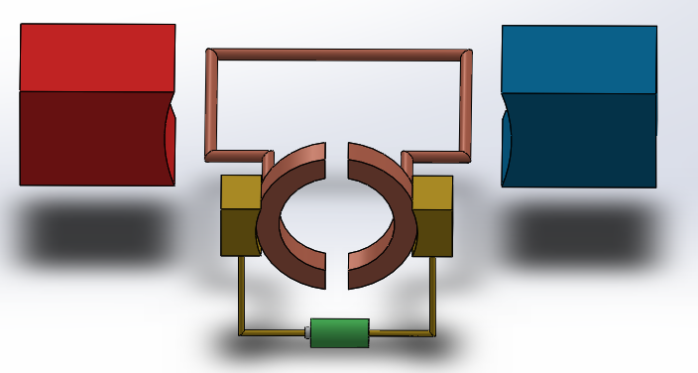
How does DC Motor work
1. Permanent Magnet creates constant magnetic field from N to S
F
N
I
S
B
F
3. Lorentz’s Law & Fleming’s Left Hand Rule: A force is created in the direction shown by green arrows (counter clockwise).
+
-
2. DC power supply (e.g. battery) provides current in one direction

Slide 61
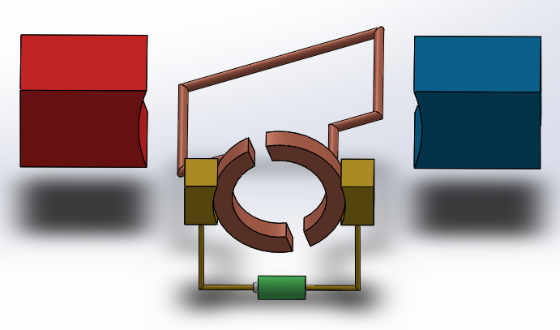
How does DC Motor work (continued)
F
N
I
B
S
F
4. The coil rotates.
Note: The brush and the commutator ring keep in contact, supplying current to the coil.

Slide 62
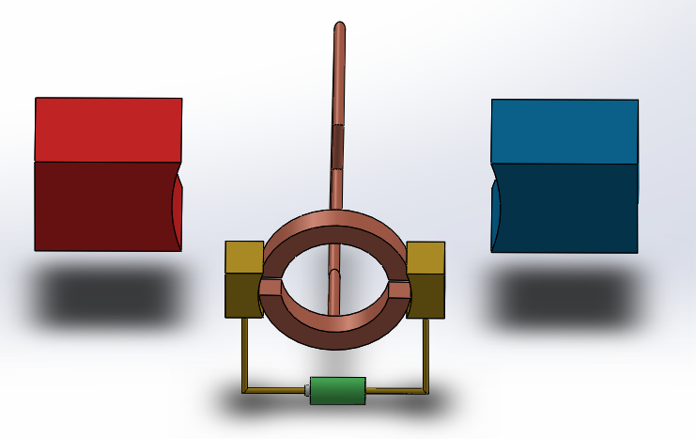
How does DC Motor work (continued)
No current passes through coil
N
B
S
I
I
5. When the coil turns to almost 90̊, both commutators and brushes are touching → short circuit → No current flows through the coil → No force.
However, rotor inertia ensures that the coil keeps rotating.

Slide 63
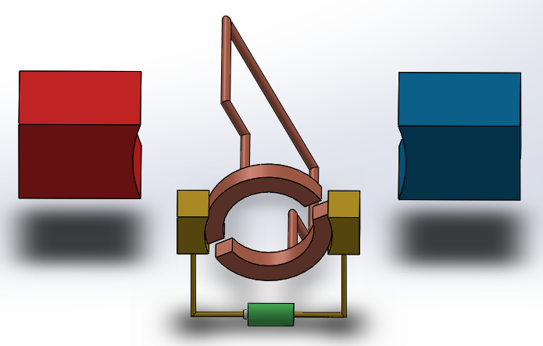
How does DC Motor work (continued)
I
N
B
S
F
F
6. After a while, the short circuit situation ends.
Current flows again into screen in left half plane & out of screen in right half plane as before.
Therefore force is still in the same direction → continuous rotation!

Slide 64
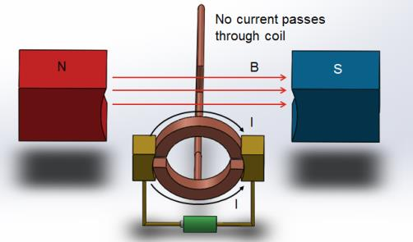
Problem with Single Coil
As shown in step 5 previously, there will be a short instance when force / torque will be zero.
Irregular motion.
Motor cannot start at this position. Two ways to see this:
There is no current in the coil due to short circuit.
Even IF there were currents in the coil (which does not happen), the two forces are colinear and thus creates no torque.

Slide 65
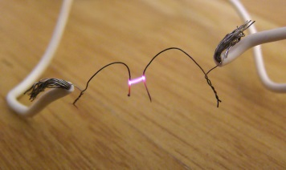
Problem with Single Coil
The short circuit uselessly consumes power without producing any motion.
In small battery-powered motor this is not too harmful.
However in big motors (e.g. several hundred watts of power), shorting can result in commutator heating and brush damage.
In some homebuilt hobby motors, the gap between the commutator is made wider than the brush to avoid shorting.
However, the coils have inductance and current cannot stop suddenly. Current attempts to jump between the gap and creates arcing.
Arcing
https://commons.wikimedia.org/wiki/File:Electric_arc.jpg

Slide 66
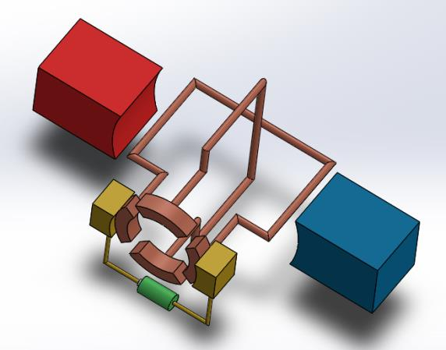
Improvement over Single Coil
The problem with zero torque and short circuit can be improved by adding more loops.

Slide 67
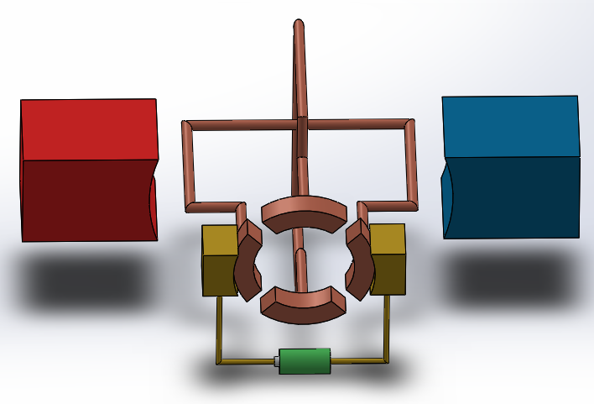
Improvement over Single Coil
The problem with zero torque and short circuit can be improved by adding more loops.
I
F
B
F
At 0̊, current flows through the first coil, similar to previous cases.

Slide 68
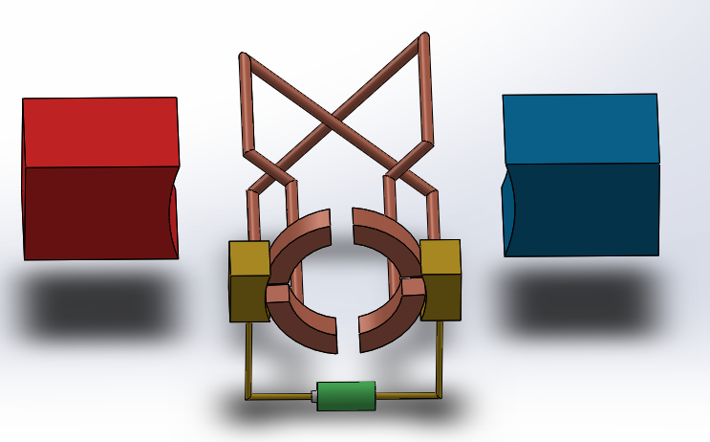
Improvement over Single Coil
F
I
F
B
I
F
F
At 45̊, even when brush touches two commutators, there is no short circuit!
Current continues to flow through coil and generates force.

Slide 69

Improvement over Single Coil
Also, there is no position where there is no torque produced.
Shown in example are two loops.
The more such loops, the smoother the motor rotation.

Slide 70
Characteristics of PM DC Motors
Permanent magnet (PM) DC motors are lighter and smaller than other equivalent DC motors because field strength of PM is high.
Easily reversed by switching the direction of applied voltage.
Ideal for control applications.
Linearity of torque-speed curve and current-torque curve.
However, they are used only in low-power applications.
Rated power usually limited to 5 hp (3728W).
torque
current
speed
torque

Slide 71
How to Read DC Motors Specs (1)
Nominal Voltage: The voltage that corresponds to the highest motor efficiency.
If operate outside of its nominal value, efficiency goes down → require additional current, generate more heat and decreasing lifespan of motor.
There is sometimes an operating range around the nominal voltage where the motor will still run well, though not as efficient as exactly at nominal V.
No Load RPM: How fast the final output shaft rotates assuming nothing is connected to it.
Usually associated with the nominal voltage.
If the motor has a gear down and the speed is not indicated separately, then the no load RPM is the speed after the gear down.

Slide 72
How to Read DC Motors Specs (1)
Power Rating:
Can be approximated as (no load current) x (nominal voltage).
Maximum power can be approximated as (stall current) x (nominal voltage). → Should only be used for a short time.
Torque: Force x Distance
E.g. a motor rated at a stall torque of 10Nm can hold 10N at the end of 1m, or 20N at the end of 0.5m.

Slide 73
How to Read DC Motors Specs (2)
Stall Torque: Maximum torque a motor can provide with the shaft no longer rotating.
Motor will damage if subjected to stall conditions for more than a few secs.
When choosing a motor, consider subjecting it no more than 1/3 of it.
For geared motor, the stall torque is after the gear down (at final shaft).
Stall Current: The current which the motor will draw under maximum torque conditions.
The value can be very high.

Slide 74
Content
Introduction
Solenoids and Voice Coil Actuators
Stepper Motors
Magnetic Levitation
Permanent Magnet DC Motors
Electromagnet DC Motors
Brushless DC Motors

Slide 75
Electromagnet DC Motor
Instead of using permanent magnet to create the magnetic field, we can also use electromagnets to do the same.
The electromagnet can be powered by using the same power source as the armature coil.
By connecting the power lines differently, we get two types of motors:
Series motor
Shunt motor
B
I
I

Slide 76
Series Motor
The electromagnet windings are in series with the armature coil / commutator / brush
Very high starting torque.
Very high speed when load is small.
Speed drops drastically with the load.
torque
speed
Coil
V
Motor
current
I
I
torque

Slide 77
Shunt Motor
The electromagnet windings are parallel to the armature coil / commutator / brush
Almost constant speed over a large range of loading.
Lowest starting torque of any of the DC motors.
Nearly constant
torque
speed
Coil
V
Motor
current
R
I₁
I₂
I₁
I₂
torque

Slide 78
Back EMF
Back EMF is generated in DC motor’s rotating loop.
Voltage which pushes against the current which induces it.
Due to rule of magnetic induction.
It reduces the armature current:
V_{emf} is proportional to the rotor speed.
Initially, speed is zero thus V_{emf} is zero.
The current I could be very high. Harmful for rotor.
Thus proper starting mechanism that controls starting input voltage is necessary in large DC motor.
I
V_{emf}
I
V

Slide 79
Universal Motor
Let’s look at the series motor again. We know that it could run on DC supply.
What if we supply it an alternating current (AC)?
In positive and negative halves of AC, not only does the current change direction.
The magnetic field also changes direction.
Torque remains in the same direction!
Series motor can run on AC as well → Universal!
Modified for better performance: laminated core instead of solid piece, to reduce eddy current loss due to fluctuating magnetic field.
N
S
S
N
I
I
I
I
F
F
.
.
X
X
F
F

Slide 80
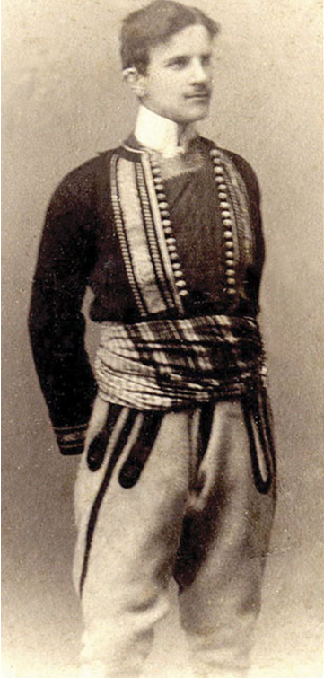
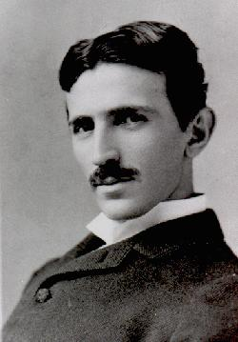

Nikola Tesla 10 July 1856 – 7 January 1943

Slide 81
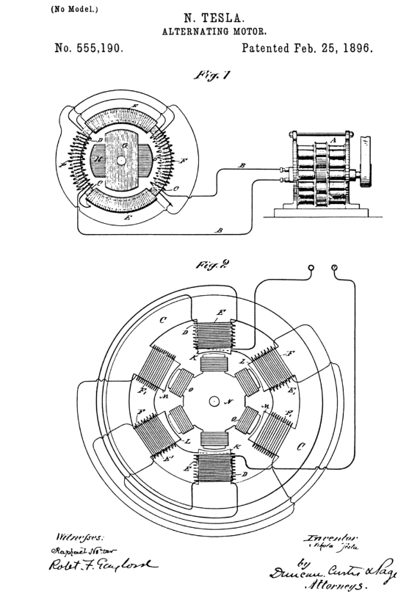

Slide 82
Tesla Induction Motor: Stator
AC windings are physically separated
Angle between windings is 2π/3 (120⁰)
Voltage range is up to 33kV
The ends of three phase windings are connected in
Star, or
Delta configuration
Star
Delta

Slide 83
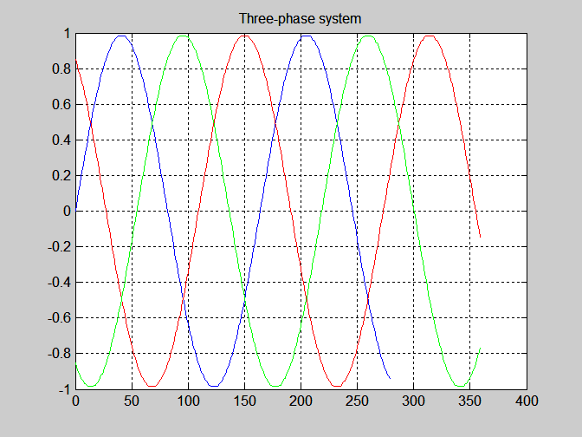
Three-phase Power System
Phasor
Diagram
Va
Vb
Vc
Vc
Va
Vb

Slide 84
Three-phase Induction Motors
Most widely used
Nearly all motors above 3kW are three-phase induction motors
Economical
Long life
Less maintenance

Slide 85
Stator
Stator windings are star or delta connected
They use three-phase AC
=> Rotating
Magnetic Field
is Generated
c
3 Φ
a
Stator or
Armature
.
X
Rotor
b
b
.
X
.
X
c
a

Slide 86
Rotating Magnetic Field
Sinusoidal space distribution
It is changing, rotating and so generates current in the rotor
Rotor windings are always short-circuited

Slide 87
AC Motors
https://www.youtube.com/watch?v=awrUxv7B-a8
https://www.youtube.com/watch?v=AQqyGNOP_3o

Slide 88
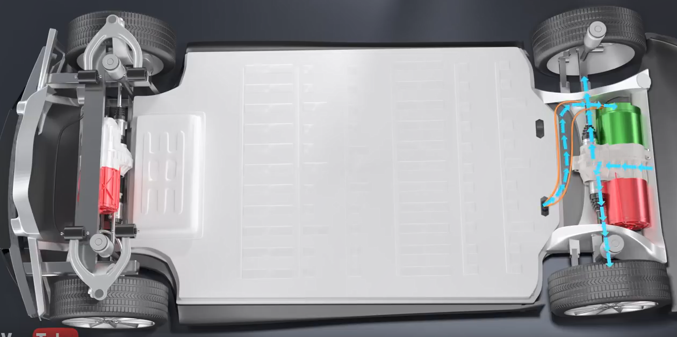
TESLA Electrical Car
DC to AC
Conversion
Battery
Tesla
Three Phase
AC Induction Motor

Slide 89
Content
Introduction
Solenoids and Voice Coil Actuators
Stepper Motors
Magnetic Levitation
Permanent Magnet DC Motors
Electromagnet DC Motors
Brushless DC Motors

Slide 90
Brushless DC Motor
The brush in DC motor is one of the weak links of the motor:
Can be worn out → need replacement → Not suitable for long life operation.
Can be noisy.
Arcing during commutation.
Brushless DC (BLDC) motor:
More reliable.
Less noise.
Lighter compared to brushed motor at same power output.

Slide 91
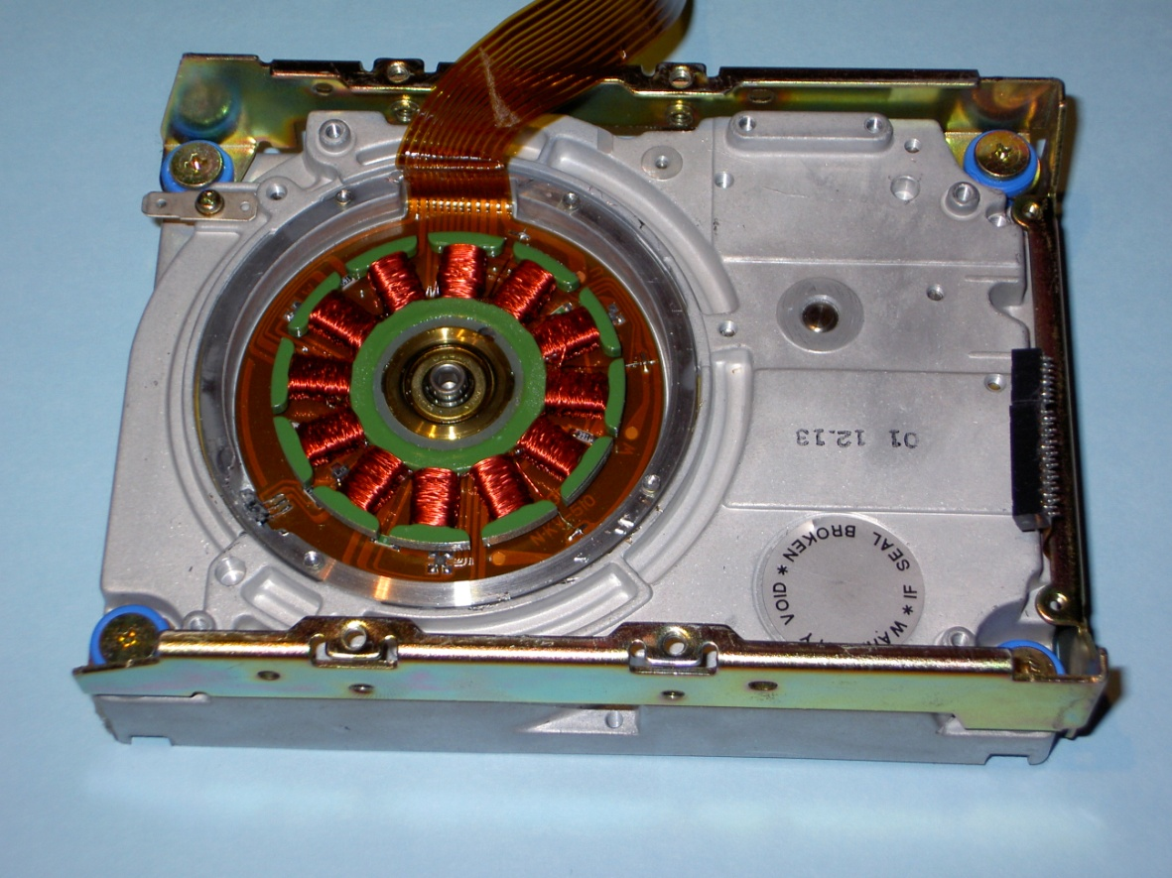
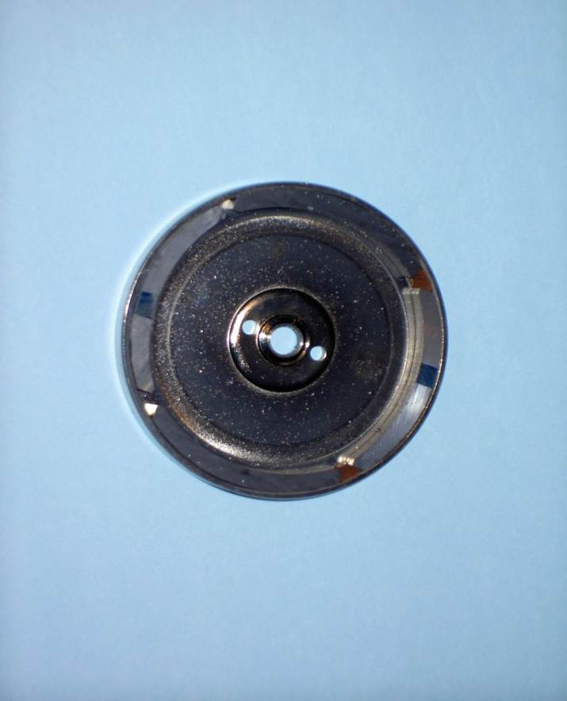
BLDC -Hard Disk Spindle Motor
Stator /
Field Pole
Magnetic Circuit Path
Permanent Magnet
ROTOR

Slide 92
How does BLDC Motor Works
Rotor with PM attached
N
1. Energize the stator coils “next to” PM with polarity to attract the rotor.
Stator
N
4. The PM’s continue to be attracted to the new stator poles, and continues to rotate towards the poles.
C
B
N
S
S
A
S
N
2. The PM’s are attracted to the stator coils and rotates accordingly.
A
B
S
C
3. Before the PM’s reach the stator’s coils, another set of coil is energized.
N
N
5. By continuing with the current pattern, the BLDC motor keeps rotating.
S
S

Slide 93
To Increase the Torque
attracts
attracts
repels
N
N
The torque can be increased by using two sets of coils simultaneously.
Note the polarity in illustration!
In the previous method, only one set of coil is energized at a time → reduced power.
C
B
A
S
S
attracts
repels
attracts
A
The current pattern is shown in the left figure.
B
C

Slide 94
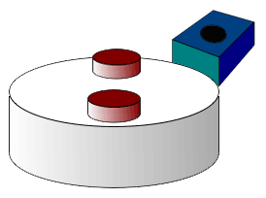
BLDC Position Sensoring
In BLDC motor, it is necessary to know the position of the rotor, in order to activate the correct coils with correct polarity.
Need sensor!
Mostly hall sensor since they can detect magnetic object.
Hall Effect Sensor Detecting Magnets
https://commons.wikimedia.org/wiki/File:Hall_sensor_tach.gif

Slide 95
Comparison with Stepper Motor
There seems to be some similarities between BLDC and Stepper Motor. However there are differences:
 | Stepper Motor | BLDC Motor
Intended Applications | Steps | Smooth Motion
Sensing | Not required. Can run in open loop | Required to energize coils at correct time
Torque | Want to maximize holding torque, in order to stay at a position even under opposing torque | Rotor lags behind the stator so that current generates maximum torque
No. of Poles | Want many poles (e.g. hybrid synchronous) to have many steps for high precision | Less poles / steps.

Slide 96
Thank you!
Any Questions?

